Slide 1
Mack/Murphy Unchained
CLRS 2018 Anaheim CA Daniel Murphy Trinostics

Slide 2
ChainLadder sample GL triangle ‘GenIns’
(in thousands)

Slide 3
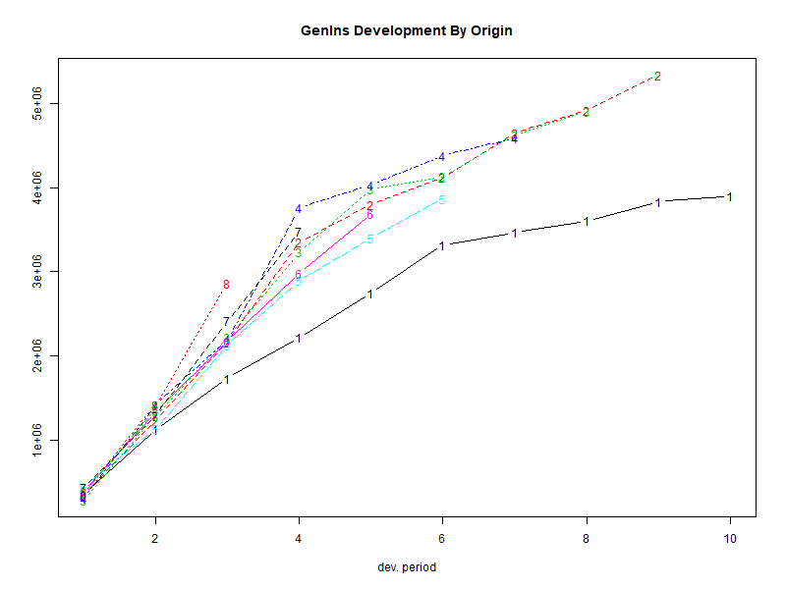
plot(GenIns)

Slide 4
ChainLadder::MackChainLadder(GenIns)

Slide 5
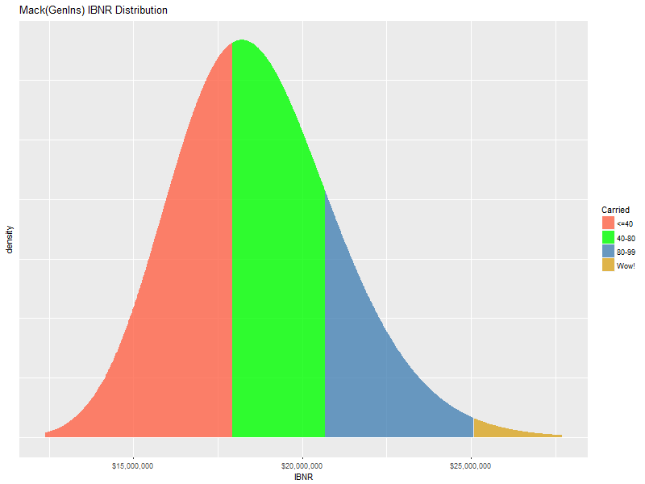
Safety Levels of GenIns Carried IBNR

Slide 6
GenIns at the Claim Level
Hai You generated simulations of over 5000 synthetic claims whose accident year aggregation is “close to” GenIns
We pegged the 13% cv as the measurement of similarity
Claim-characteristic choices included:
Frequency distribution
Severity distribution
Distribution for the number of payments per claim
Report lag and payment lag
The purpose of this exercise was to compare the Mack results on the aggregated triangle versus the claim detail

Slide 7
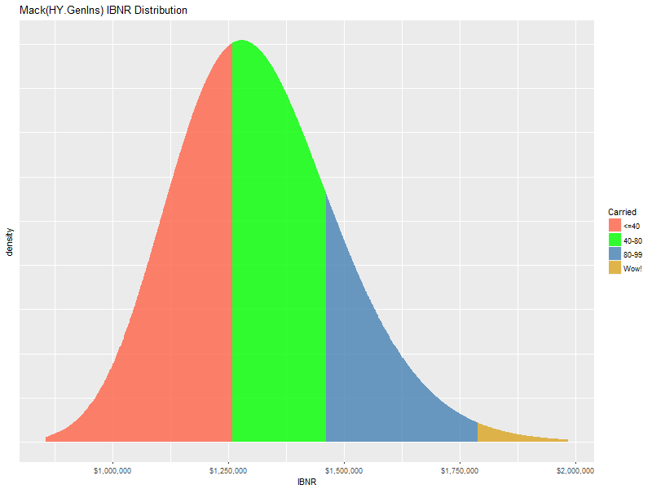
IBNR distributions have same shape
Original GenIns
Aggregated triangle from Hai data

Slide 8
GenIns at the Claim Level: Claim detail sample in triangle format
Wo! What happened?
Could it be the development factors?

Slide 9
To be continued … ☺
> attr(ata(GenIns), "vwtd")
1-2 2-3 3-4 4-5 5-6 6-7 7-8 8-9 9-10
3.490607 1.747333 1.457413 1.173852 1.103824 1.086269 1.053874 1.076555 1.017725
> attr(ata(HY.GenIns), "vwtd")
12-24 24-36 36-48 48-60 60-72 72-84 84-96 96-108 108-120
3.412879 1.608162 1.293365 1.181609 1.118462 1.082687 1.062238 1.044175 1.046972
> attr(ata(dat), "vwtd")
12-24 24-36 36-48 48-60 60-72 72-84 84-96 96-108 108-120
1.287861 1.205773 1.150838 1.120326 1.086169 1.066163 1.052599 1.040253 1.042831
Then I’ll show the x-y graph of the data points and all will become clear
I’ll keep you posted, Hai

